Slide 1
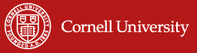
Index-Based Livestock Insurance:
The why, how, and positive impacts of an imperfect product
Christopher B. Barrett, Cornell University
Cornell Institute for China Economic Research
Summer Institute
July 17, 2019

Slide 2
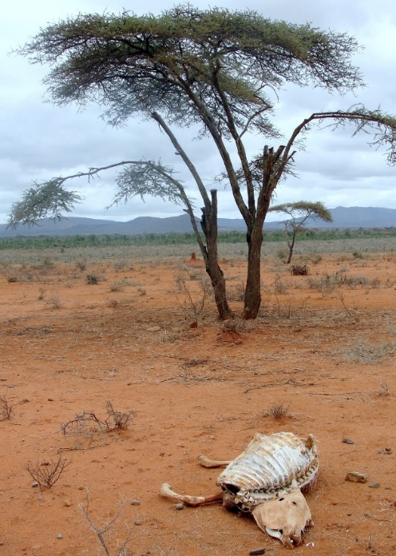
Why IBLI? Poverty Traps And Catastrophic Risk
Poverty traps exist in the arid and semi-arid lands (ASAL) of Kenya/Ethiopia. Catastrophic herd loss risk due to major droughts is the major cause of these dynamics. Puts a premium on drought risk management, both for individuals and for society.
Sources: Lybbert et al. (2004 EJ) and Santos & Barrett (2011 JDE, 2019 UCP/NBER volume) on Boran in s. Ethiopia. Barrett et al. (2006 JDS) and Chantarat et al. (2017 WD) among n. Kenyan pastoralists.
In the presence of stochastic poverty traps, the ‘paradox of social protection’ implies high social returns to effective risk protection. (Ikegami et al. 2019 UCP/NBER volume).

Slide 3
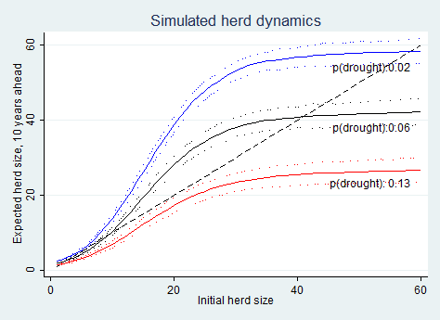
Why IBLI? Increased Risk From Climate Change
Pastoralist systems adapted to climate regime. But resilient to a shift in climate? Many models predict increased rainfall variability (i.e., increased risk of drought).
Herd dynamics differ b/n good and poor rainfall states, and so change with drought (<250 mm/ year) risk.
In southern Ethiopia, in expectation, doubling drought risk leads to system collapse in the absence of any change to prevailing herd dynamics.
Source: Barrett and Santos (Ecol Econ 2014)

Slide 4
Why IBLI? Standard Responses to Drought
Standard responses to major drought shocks:
1) Post-drought restocking (futile at low levels, Santos & Barrett 2019 NBER)
2) Food aid (slow, expensive, can reinforce sedentarization, lots of excess mortality Nikulov et al. PLoS ONE 2016)
Core issue, “the social protection paradox”: If transfers go only to those already in a poverty trap, the poor population grows as shocks knock more non-poor into the poverty trap. Over time, social protection resources get exhausted. (Ikegami et al. 2019 NBER)

Slide 5
Why IBLI? An Alternative Response
(Semi-)Commercial insurance can perhaps:
  Prevent downward slide of vulnerable populations
  Crowd-in investment and accumulation by the poor
  Induce financial deepening by crowding-in credit
  Let us focus humanitarian resources on the truly needy
But can insurance be sustainably offered in the ASAL?
Conventional (individual) insurance unavailable b/c:
  Very high transactions costs, esp. w/little financial intermediation among pastoralists
  Moral hazard/adverse selection

Slide 6
Why IBLI? The Potential of Index Insurance
Index insurance is a variation on traditional insurance:
  Do not insure individual losses.
  Instead insure some “index” measure that is strongly correlated with individual losses.
  (Examples: rainfall, remotely sensed vegetation index, area average yield, area average herd mortality loss).
  Index needs to be:
    objectively verifiable
    available at low cost in real time
    not manipulable by either party to the contract

Slide 7
Why IBLI? The Potential of Index Insurance
Index insurance can obviate the problems that make individual insurance unprofitable for small, remote clients:
  - No transactions costs of measuring individual losses
  - Preserves effort incentives (no moral hazard) as no single individual can influence index
  - Adverse selection reduced as payouts do not depend on the riskiness of those who buy the insurance
Index insurance can, in principle, be used to create a timely, financially sustainable, self-targeting safety net to protect pastoralists against catastrophic drought shocks.
Could also accelerate herd recovery, altering herd dynamics and averting system collapse if drought frequency increases. Perhaps crowd in value-adding investments, too!

Slide 8
How IBLI? Major Challenges of Index Insurance
High quality data (reliable, timely, non-manipulable, long-term) to design/price product and to determine payouts
Minimize uncovered basis risk through product design. Is it insurance or a lottery ticket? All turns on basis risk!!!
Innovation incentives for insurers/reinsurers to design and market a new product and global market to support it
Establish informed effective demand, especially among a clientele with little experience with any insurance, much less a complex index-based insurance product
Low cost delivery mechanism for making insurance available for numerous small and medium scale producers

Slide 9
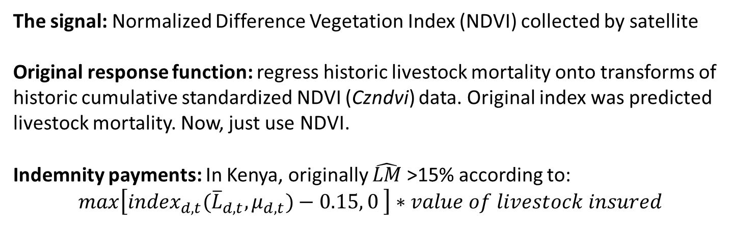
(Jensen, Barrett &2014)
How IBLI? Original Product Design
The signal: Normalized Difference Vegetation Index (NDVI) collected by satellite
Original response function: regress historic livestock mortality onto transforms of historic cumulative standardized NDVI (Czndvi) data. Original index was predicted livestock mortality. Now, just use NDVI.
Indemnity payments: In Kenya, originally $\hat{LM}$>15% according to:
$max\left[{index}_{d,t}({\overline{L}}_{d,t}, μ_{d,t})−0.15, 0 \right]∗value of livestock insured$
Temporal Structure of IBLI contract:
12 month contract sold during 2-month sales windows just prior to usual start of seasonal rains. Payouts March 1 and/or October 1.
Details in Chantarat et al. JRI 2013

Slide 10
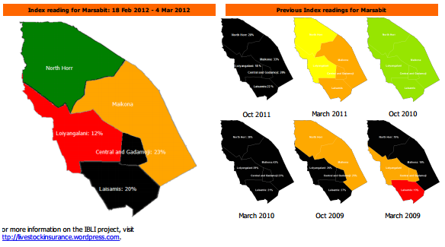
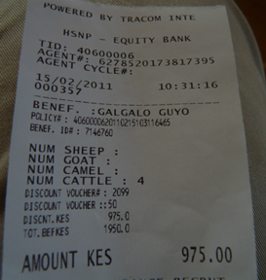
(Jensen, Barrett &2014)
How IBLI? Implementation
Commercial underwriters: In Kenya: UAP, APA, Takaful. In Ethiopia: OIC
International reinsurers: Swiss Re, Africa Re
Lots of implementation challenges.
IBLI team developed extension/financial education programs to (randomly) inform and educate prospective buyers.
Payouts have occurred as designed! ☺

Slide 11
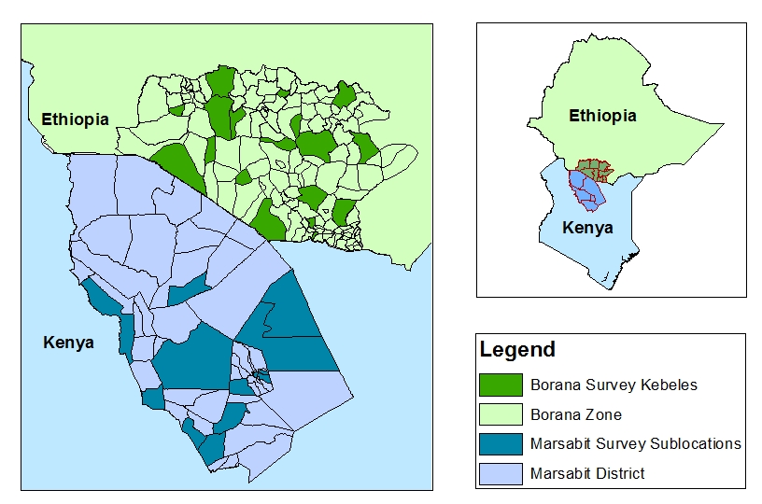
(Jensen, Barrett &2014)
How IBLI? Pilots in Ethiopia and Kenya
IBLI products (and IE surveys) launched in Marsabit, Kenya in Jan 2010 (Oct 2009) and in Borana, Ethiopia, in Aug 2012 (Mar 2012).
Kenya sampling overlaid with HSNP coverage and randomized premium discount coupon distributions as research design.

Slide 12
IBLI Uptake Significant … But So Is Disadoption
In HH surveys , in Borana (Ethiopia)/Marsabit (Kenya):
54/47% ever purchased IBLI within first 4 sales periods
But repurchase rates low: 18-68%/16-27%
High rates of disadoption : 31/41% within 2 years
Sample restricted to 489/820 panel households.

Slide 13
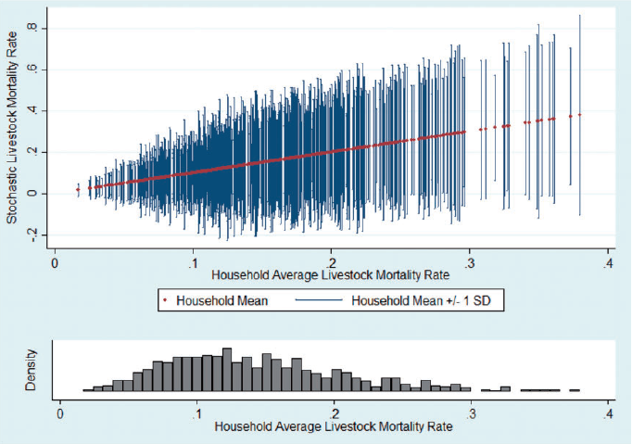
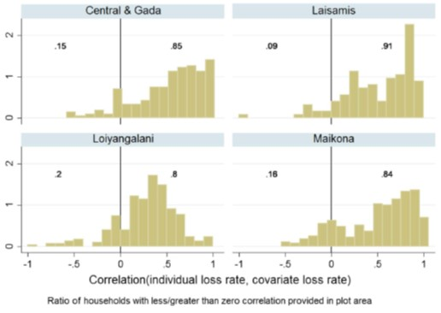
IBLI: A Highly Imperfect Product
Covariate risk is important but household losses vary a lot …
… even for a given hh over time ...
Notes: Household-season herd loss rate spreads (mean in red, ±1 SD in blue), ordered by hh avg loss rate (top), and distribution of hh avg loss rates (bottom).
Notes: The left figure illustrates the covariate (average) loss rate in each season. The right figure illustrates the distribution of losses within each seasons. The boxes depict the interquartile range, the upper and lower adjacent values are either 3/2 the interquartile range or the value furthest from the median. The remaining observations fall outside the adjacent values.
… or on average. Lots of unavoidable basis risk.
Jensen, Barrett & Mude AJAE 2016; Jensen, Mude & Barrett FP 2017

Slide 14
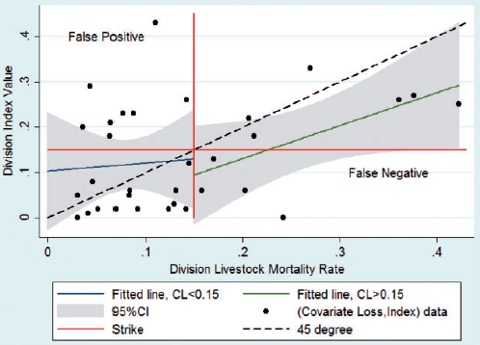
(Jensen, Barrett & 2014)
IBLI: A Highly Imperfect Product
And then there’s design risk … the original index did not perfectly track covariate losses despite the design strategy.
Notes: Covariate loss-index observations are seasonal division average mortality paired with the index value for that division-season. Fitted lines and confidence intervals are generated by regressing livestock mortality rates on the index.
- Result: IBLI hhs still hold most risk: 62-77% of total risk exposure remains
Most basis risk is idiosyncratic and random, not targetable or correctable.
Significant design risk (unintended systematic underpayment)
- Significant spatial variation in covariate share – geographically target IBLI?
Jensen, Barrett & Mude AJAE 2016

Slide 15
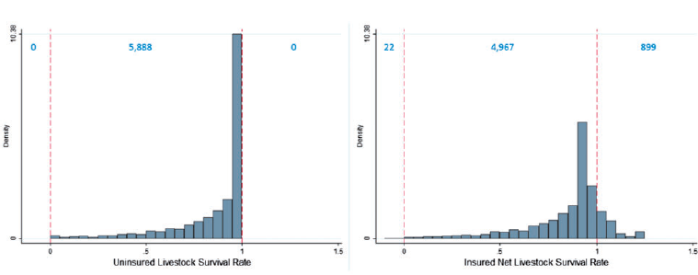
(Jensen, Barrett &
IBLI: A Highly Imperfect Product
Because of basis/design risk, esp. false negatives, IBLI cannot stochastically dominate no insurance. ‘Do no harm’ concerns.
Survival rate w/o insurance (L) and net of prem/indemnity payments w/IBLI (R).
Note: - small probability of negative survival rates!
- increased dispersion of outcomes due to false payments>losses
Jensen, Barrett & Mude AJAE 2016

Slide 16
Key determinants of IBLI uptake
General uptake findings — robust across specifications and surveys
Price: Price inelastic response to premium rate.
Design Risk: Design error reduces uptake; greater effect at higher premium rates.
Idiosyncratic Risk: Hh understanding of IBLI increases effect of idiosyncratic risk.
Understanding: Extension/marketing improves accuracy of IBLI knowledge but no independent effect of improved understanding on uptake.
Herd size: Likelihood of uptake increasing in HH herd size.
Liquidity: IBLI purchase increasing w/HSNP participation and HH savings.
Intertemporal Adverse Selection: HHs buy less when expecting good conditions.
Spatial Adverse Selection: HHs in divisions with covariate risk are more likely to purchase and with greater coverage (spatial adverse selection).
Gender: no gender diff in uptake. Women more sensitive to risk of new product.
Sources: Bageant & Barrett JDS 2016; Takahashi et al. WD 2016; Jensen, Mude & Barrett FP 2017)

Slide 17
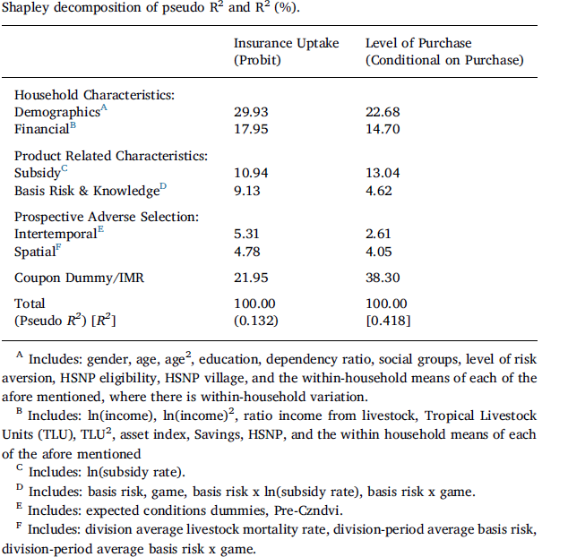
Key determinants of IBLI uptake
No one factor dominates the others in explaining demand patterns.
Source: Jensen, Mude & Barrett FP 2017)

Slide 18
Key determinants of IBLI uptake
Demand depends a lot on less poor herding households and on insurance company loadings on premium rate. If it’s a social protection device, might need government/donor subsidy.
Source: Chantarat et al. WD 2017

Slide 19
IBLI’s Positive Impacts
IBLI coverage:
Increases animal health expenditures, milk income/TLU, total hh income, child MUAC, and non-distress livestock sales
Reduced distress livestock sales, herd losses, and meal skipping during drought
Reduced non-drought herd size in Kenya (reduced precautionary savings?), increased non-drought herd size in Ethiopia (better ROI?)
Initially reduces herding effort, which then recovers as herders learn IBLI
Increases subjective well-being by far more than buyer’s remorse effects of lapsed insurance that doesn’t pay out.
Crowds in informal transfers within communities, addressing basis risk
Marginal impact on income or MUAC is 6-45x that of HSNP cash transfers!
Jensen, Barrett & Mude JDE 2017; Toth et al. 2018; ; Janzen & Carter; Tafere, Brrett & Lentz; Takahashi, Barrett & Ikegami - all AJAE 2019

Slide 20
IBLI’s Positive Impacts
Drought coping behavioral response to IBLI indemnity payments varies:
Poorer households: 49% reduction in skipping meals and 54% reduction in distress livestock sales. So improve immediate nutrition/human capital and safeguard future productive assets.
Wealthier households: 96% reduction in distress herd sales; no effect on skipping meals. Those who could otherwise consumption smooth can preserve their productive capital
Source: Janzen & Carter AJAE 2019

Slide 21
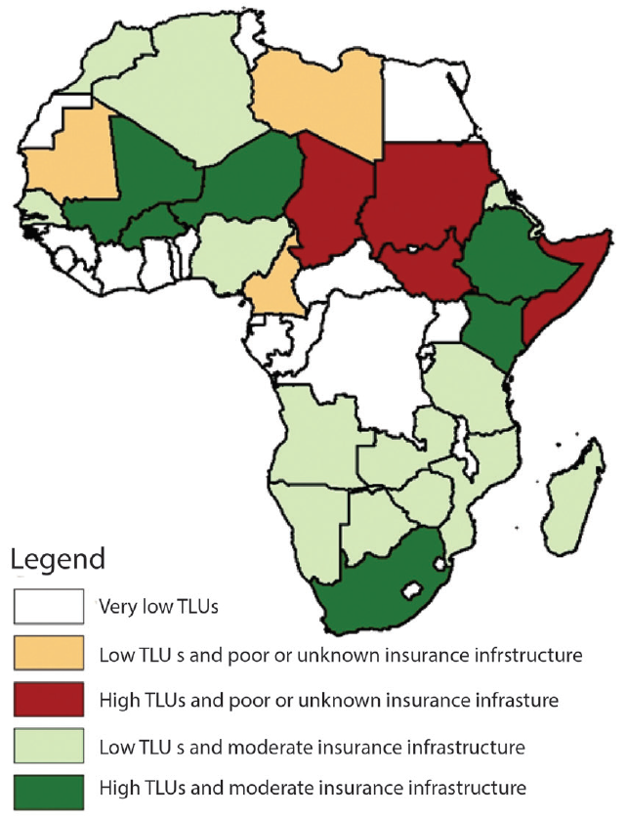
Next steps w/IBLI?
Sharia-compliant version already successfully launched (Takaful)
Kenya gov’t took nationwide through Kenya Livestock Insurance Program
Now reviewing new, appropriate sites where partners have requested help:
Significant livestock herds
face high covariate herd loss risk related to drought
adequate insurance infrastructure
Best bets for next expansions: Niger, Mali, Burkina Faso, South Africa
(higher risk sites: Chad, Somalia, South Sudan, Sudan)
(Mills et al. 2016)

Slide 22
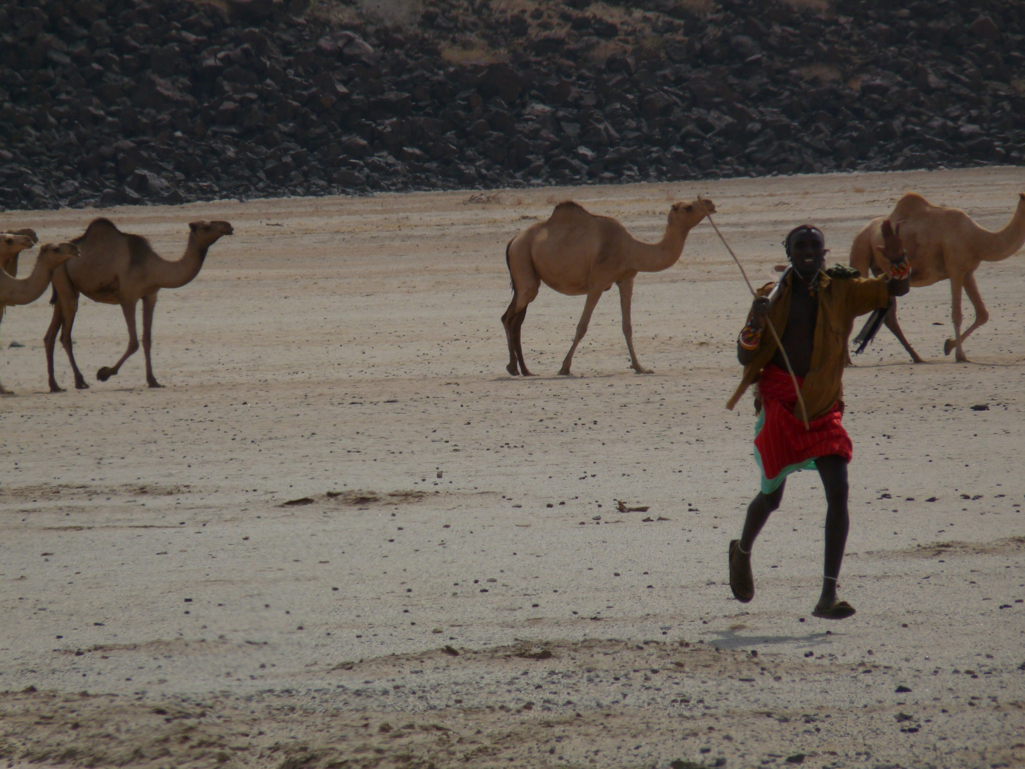
Although IBLI offers incomplete and imperfect coverage against herd loss, uptake is solid and IBLI has clear favorable impacts on purchasers.
IBLI offers a promising option for addressing poverty traps that arise from catastrophic drought risk … and impacts/$ > cash transfers
Thank you for your time, interest and comments!
For more information visit www.ilri.org/ibli/
Notes:
22

